Slide 1

CLI First Aid Care Cards
Canadian Lifeboat Institution

Slide 2


THE EMERGENCY MEDICAL SYSTEM (EMS) EVOLVED
Because it was recognized that patients who received EFFICIENT CARE PRIOR TO ARRIVING AT THE HOSPITAL had a better chance of survival and recovered more quickly

Slide 3
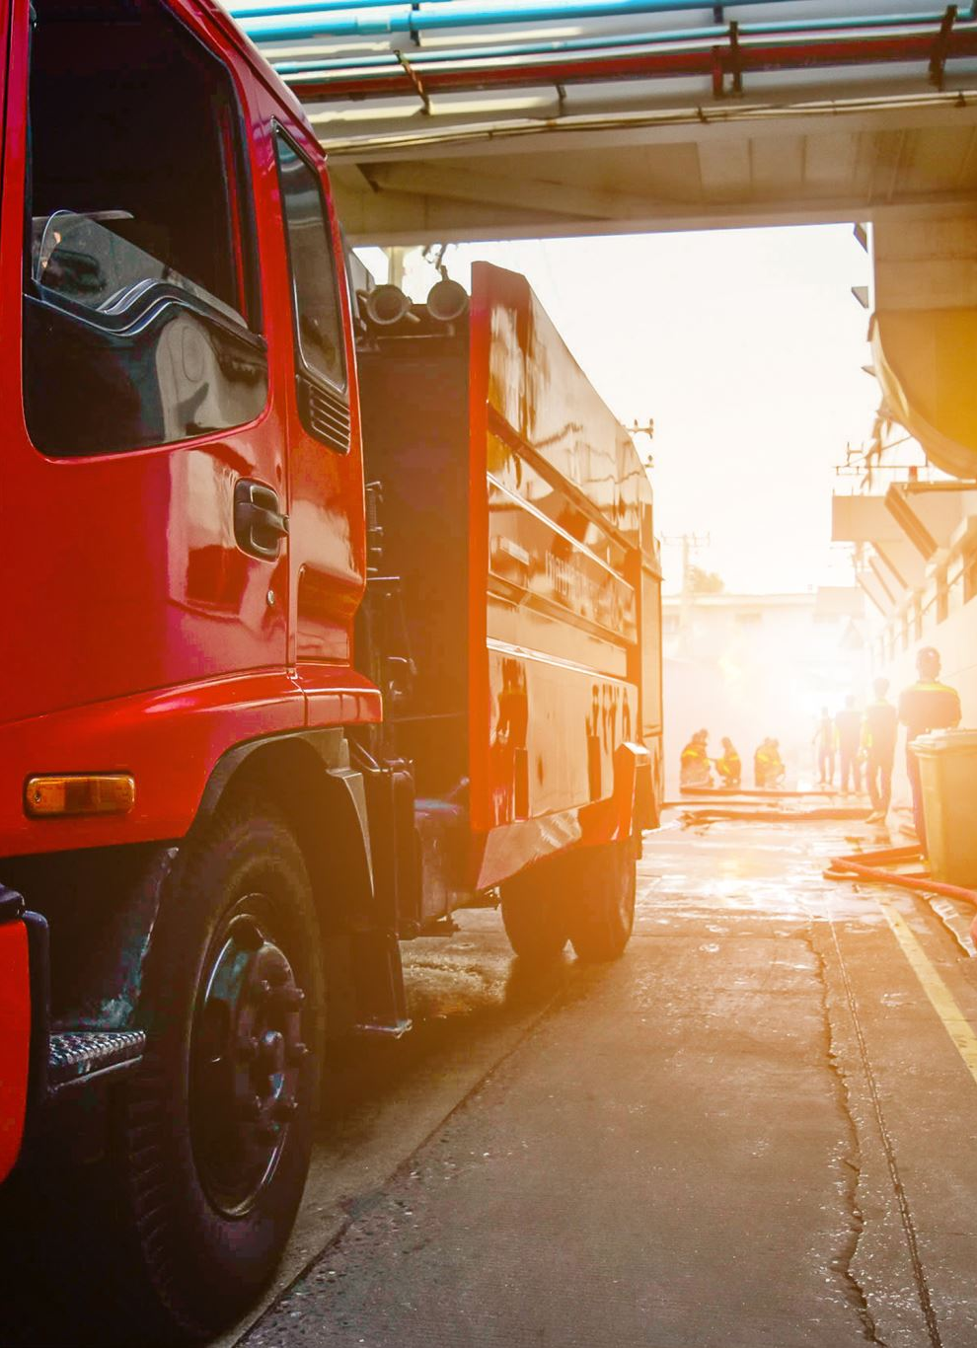
The TEAM is made up of
1. EMERGENCY MEDICAL DISPATCH
2. EMERGENCY RESPONDERS
3.AMBULANCE SERVICES
4. PHYSICIANS

Slide 4
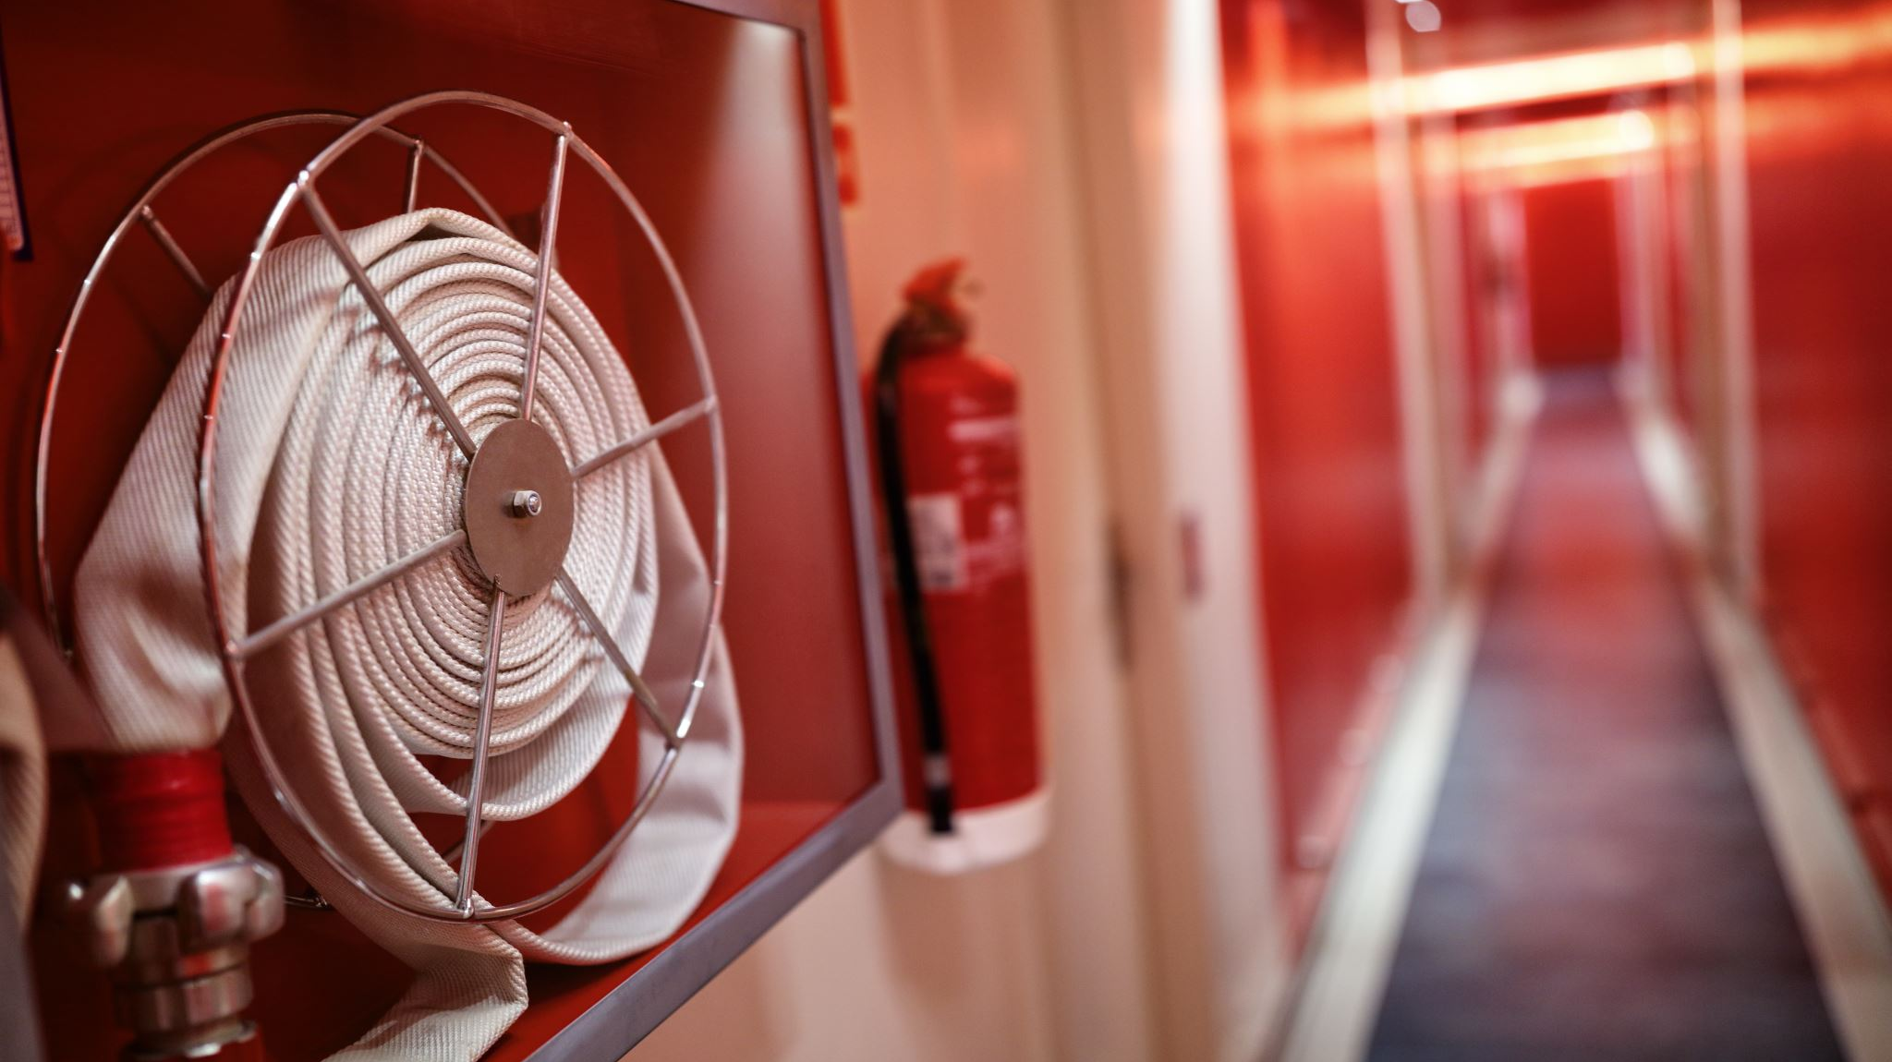
PROTECTED FROM LIABILITY
WE IN BC ARE COVERED FROM LIABILITY AT THE IMMEDIATE SCENE OF AN ACCIDENT, WHEN RENDERING FIRST AID TO AN ILL, INJURED OR UNCONSCIOUS PERSON BY THE
GOOD SAMARITAN ACT
“WE ARE REQUIRED TO PERFORM OUR DUTIES TO THE BEST OF OUR ABILITIES WHILE WORKING WITHIN OUR SCOPE OF PRACTISE AND THE LEGISLATION OF OUR PROVINCE

Slide 5
AS A FIRST AIDER WHAT ARE YOUR FIRST DUTIES….
1. GET PERMISSION, IF POSSIBLE
2. ONLY GIVE THE CARE YOU WERE TRAINED TO DO
3. CONTINUE GIVING CARE UNTIL
ANOTHER TRAINED PERSON TAKES OVEER
YOU ARE TOO EXHAUSTED TO CONTINUE
THE SCENE BECOMES UNSAFE
THE PERSON’S CONDITION IMPROVES AND CARE IS NO LONGER NEEDED

Slide 6
GETTING PERMISSION…….
1. FOR AN UNRESPONSIVE PERSON , THHE LAW ASSUMES YOU HAVE PERMISSION
2. FOR YOUNG CHILD WITHOUT A CAREGIVER, GO AHEAD AND PROVIDE CARE
3. IF A PERSON REFUSES CARE, CALLN 911 AND STAND BY IF IT IS SAFE TO DO SO

Slide 7
GETTING PERMISSION…….
1. FOR AN UNRESPONSIVE PERSON , THHE LAW ASSUMES YOU HAVE PERMISSION
2. FOR YOUNG CHILD WITHOUT A CAREGIVER, GO AHEAD AND PROVIDE CARE
3. IF A PERSON REFUSES CARE, CALLN 911 AND STAND BY IF IT IS SAFE TO DO SO

Slide 8
OTHER IMPORTANT DUTIES OF THE FIRST AIDER………
1. CLEANING AND RE STOCKING OF EQUIPMENT
2. DOCUMENTATION
3. CONTINUING FIRST AID TRAINING

Slide 9


GLOSSARY
VITAL SIGNS:
UNLESS OTHERWISE STATED VITAL SIGNS INCLUDE TAKING AND DOCUMENTING BLOOD
PRESSURE, PULSE AND RESPIRATIONS
LEVEL OF CONSCIOUSNESS
THIS ASKS YOU TO RECORD for example; ARE THEY AWAKE, ALERT, SLEEPY CONFUSED????
- DOCUMENT:
THIS MEANS WRITE ABOUT THE PATIENT’S CONDITION, TREATMENTS, WHO YOU HAV NOTIFIED,
HANDED OVER TO PLUS PERTINENT TIMES (LIKE TOURNIQUET APPLIED, 1410 )ETC.
O2 SATS, MEANS OXYGEN SATURATIONS;
as read on PULSE OXYMETER
GIVE OXYGEN AS REQUIRED;
THIS MEANS GIVE ENOUGH SUPPLEMENTAL OXYGEN TO KEEP OXYGENSATJURATIONS TO AT LEAST 95%
EMOJI: WHEN YOU SEE THIS EMOJI FINISH YOUR DOCUMEMTATION, TRANSFER THE PATIENT TO
COAST GUARD OR AMBULANCE AND GET THEM TO THE HOSPITAL
EMOJI WHEN YOU SEE THIS EMOJI IT MEANS THEY DO NOT HAVE TO GO TO HOSPITAL BUT INSTEAD CAN BE DRIVEN
HOME BY A RESPONSIBLE ADULT

Slide 10
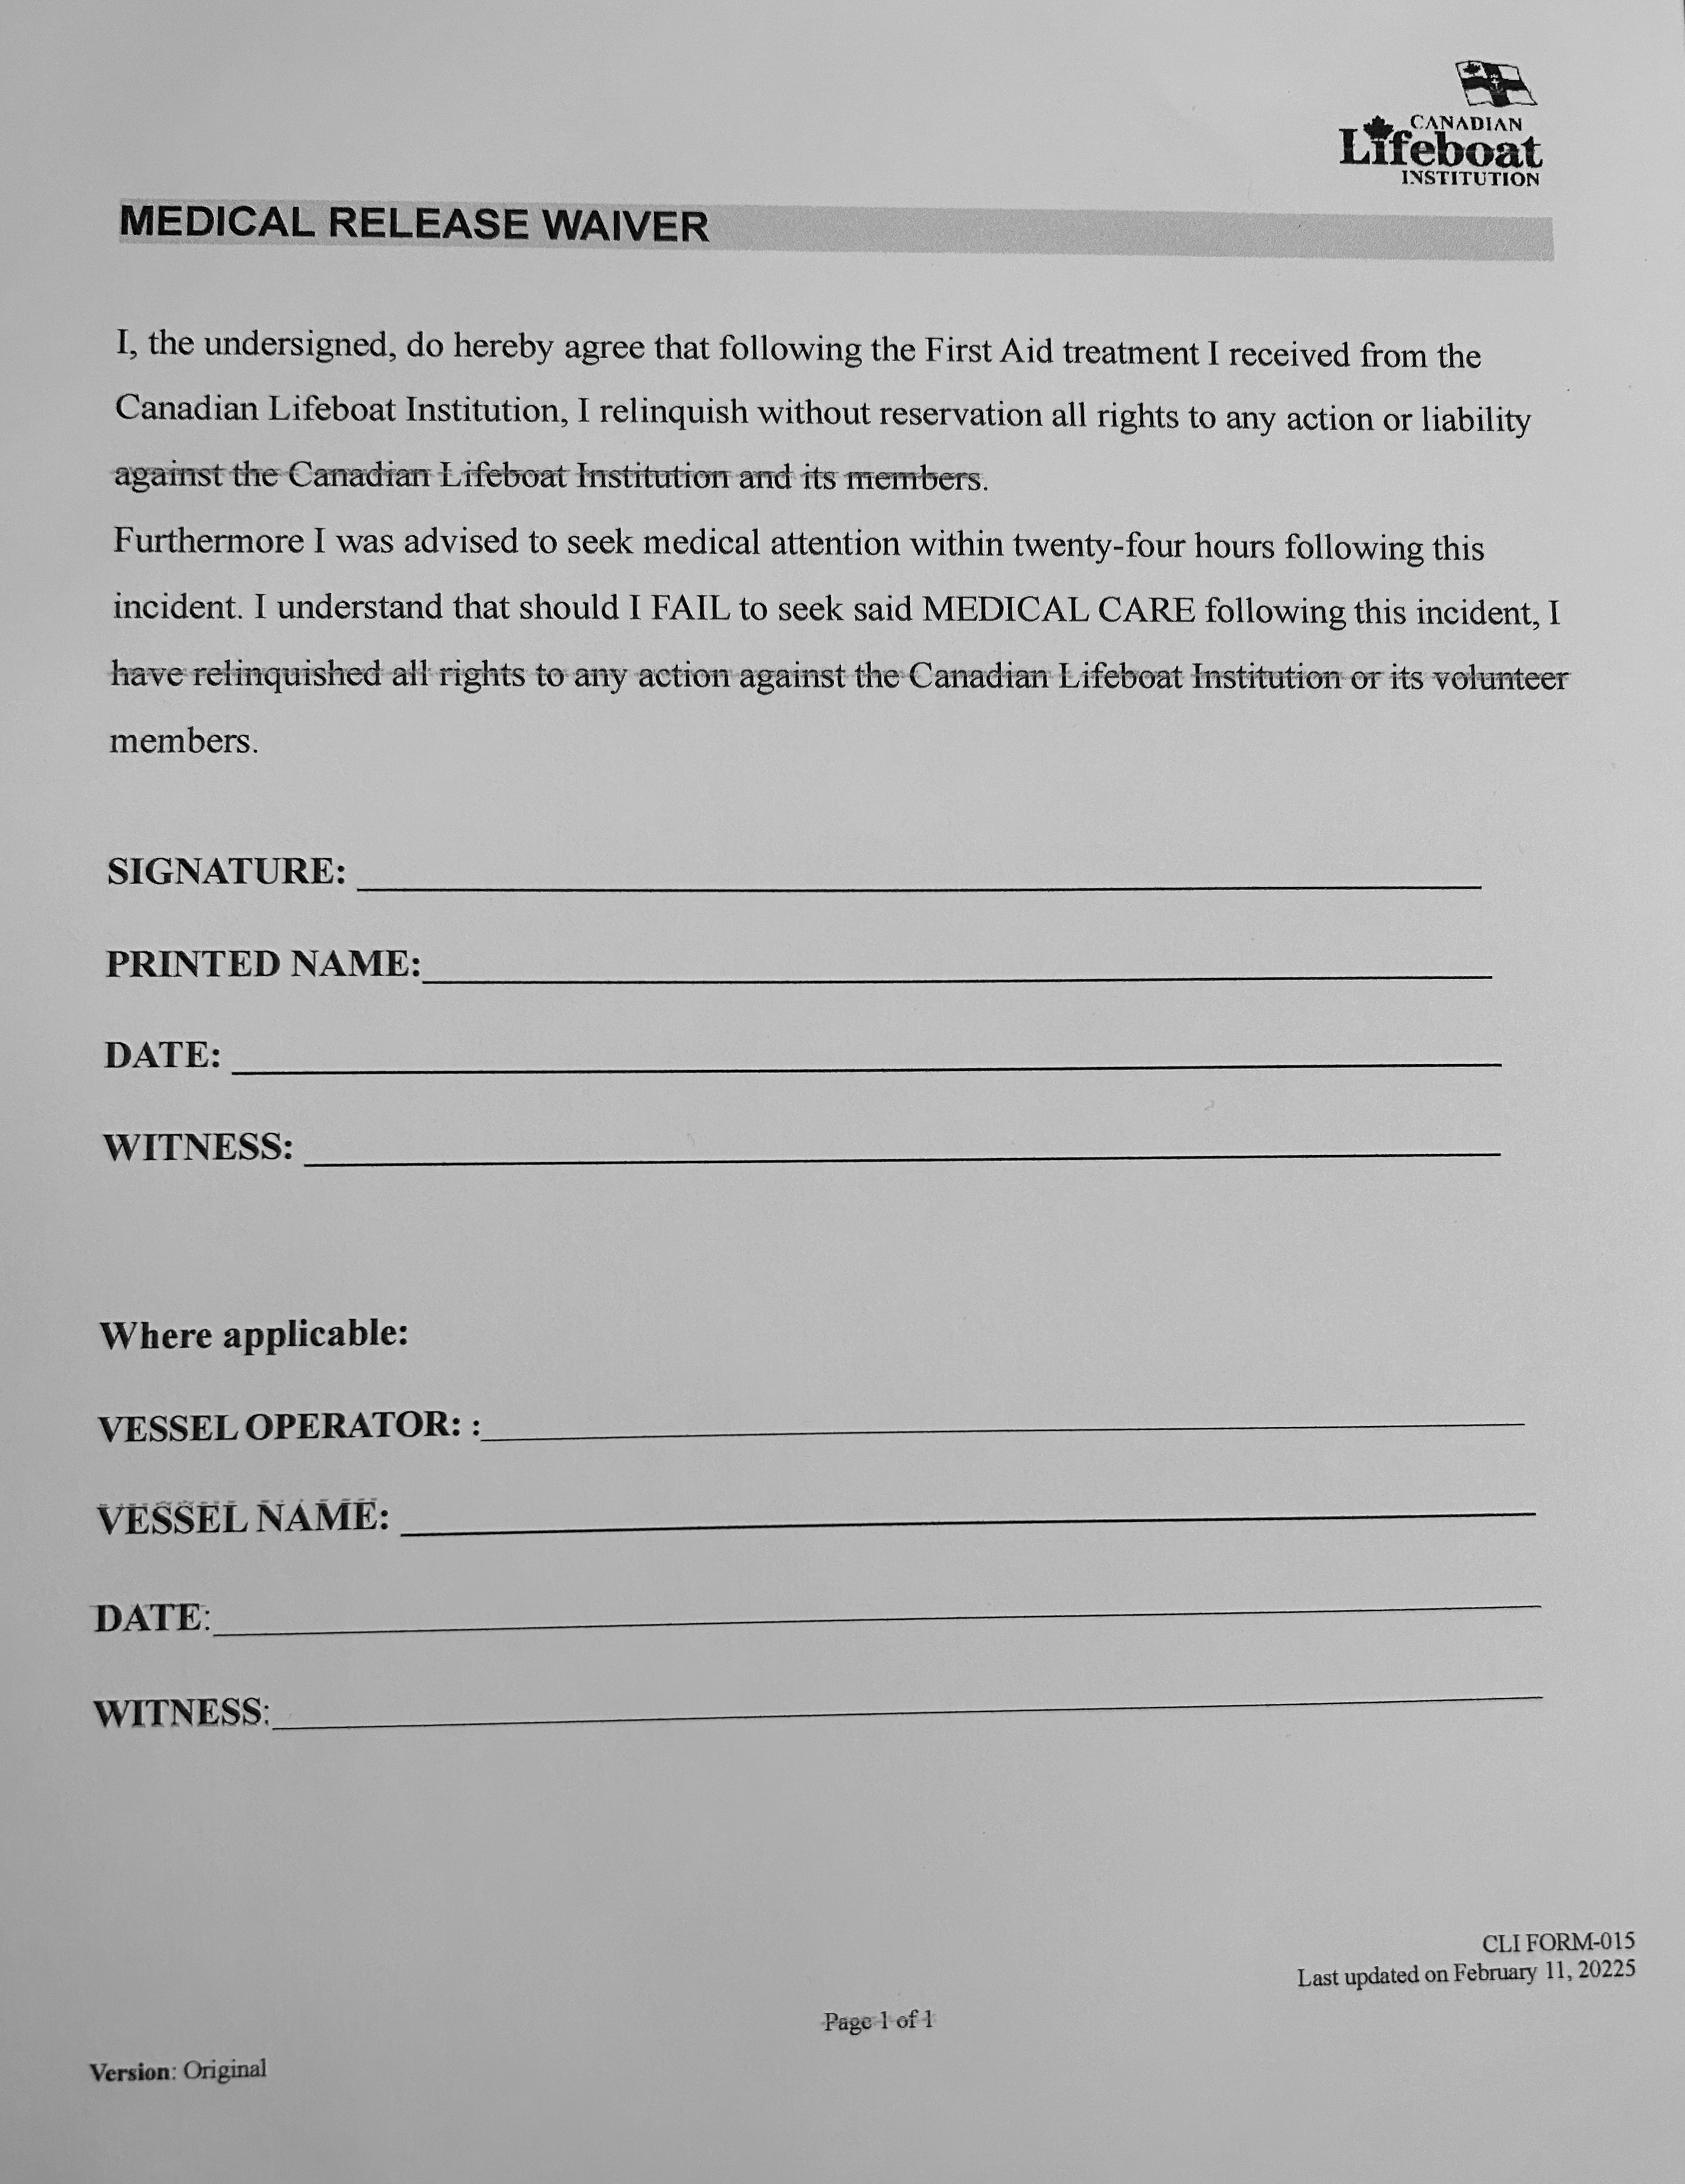
MEDICAL RELEASE FORM

Slide 11



CASUALTY PAIN SCORE
No Pain Mild Pain Moderate Pain Severe Pain
0 1 - 3 4 - 6 7 - 10
0 2 4 6 8 10
No Hurts Hurts Hurts Hurts Hurts Hurt Little bit Little Even Whole Worst
More More Lot
SPO2 Values
Normal 94 – 98%
C.O.P.D. (2/6 litres) 88 – 92%
Normal Rates per minute
Adult 12 – 20 breaths 60 – 90 pulse
Child 20 – 40 breaths 90 – 110 pulse
Baby 30 – 60 breaths 110 – 140 pulse
2016
_{July} Age Markers
⁻ AED 1 year and over BVM 1 year and over
1.0
OP Airway Base on size Tourniquet Base on size
_{VERSION} Suction 1 year and over
CASUALTY NORMAL PARAMETERS
PAIN MANAGEMENT
No Pain Mild Pain Moderate Pain Severe Pain
0 1 - 3 4 - 6 7 - 10
0 2 4 6 8 10
No Hurts Hurts Hurts Hurts Hurts
Hurt Little bit Little Even Whole Worst
More More Lot
Step 1; Positional Pain Relief
Consider, where appropriate; immobilisation, elevation, cooling, casualty position
Step 2; Casualty’s Own Medication
If available and appropriate, encourage casualty to administer their own pain relief within dosage limits
Step 3; Paracetamol - Mild to moderate pain
Administer; (under 12 years) oral suspension with dose as per packet
or (12-15 years) 1x500mg tablet or (16 years+) 2x500mg tablet as long as not allergic and no previous paracetamol in last 4 hours
Step 4; Entonox - Moderate to severe pain
USE for pain;
₂₀₂₀ • If indicated in check cards and not contra-indicated below
_{Jan} DO NOT use for;
₂ • Severe head injuries with impaired conscious level
_{ersion} • Violently disturbed psychiatric casualties
• Casualties who have been scuba diving in last 24 hours
^{V} • Chest injuries
_{Abbs} • Abdominal pain where intestinal obstruction is suspected
• Eye surgery with injection of gas in last 4 weeks
St
PAIN MANAGEMENT
CASUALTY CARE CHECK CARDS
PATIENT ASSESSMENT
EMERGENCY EVENTS
URGENT AND NON URGENT EVENTS
TRAUMA
MEDICAL CONDITIONS
IMMERSION / HEAT RELATED

Slide 12
CONTENTS
E M E R G E N C Y E V E N T S
CARD 1
CARDIOPULMONARY RESCUSITATION
CARD 2
SHOCK
CARD 3
UNCONSCIOUSNESS
CARD 4
ARTERIAL BLEEDING
CARD 5
STROKE
CARD 6
CHEST INJURIES
CARD 7
CHEST PAIN
CARD 8
RESPIRATORY AND BREATHING EMERGENCIES
CARD 9
HEAD, SPINAL AND PELVIC INJURIES
CARD 10
COLD WATER IMMERSION
CARD 11
INTERNAL BLEEDING
CARD 12
VENOUS BLEEDING
U R G E N T A N D N O N U R G E N T E V E N T S
CARD 13
WOUND CARE AND BANDAGING
CARD 14
PAIN MANAGEMENT
CARD 15
FRACTURES AND SPRAINS
CARD 16
ELECTRICAL BURNS
CARD 17
CHEMICAL BURNS
CARD 18
HEAT RELATED AND THERMAL BURNS
CARD 19
HEAT STROKE AND HEAT EXHAUSTION
CARD 20
SEIZURES
CARD 21
DIVING RELATED EMERGENCIES
CARD 22
EYE INJURIES 22a and 22b
CARD 23
NOSE BLEEDS
CARD 24
DROWNING OR COLD WATER SUBMERSION
CARD 25
DIABETIC EMERGENCIES
CONTENTS
Notes:
See email comments.

Slide 13
_{CARD 2} RESUSCITATION AND VENTILATORY SUPPORT
Possible signs and symptoms:
• Response U • Breathing Rate 0 or 6 • Pale / blue colour
TIME CRITICAL TIME CRITICAL
BREATHING 6 PER MIN NO BREATHING – CPR
– VENTILATORY SUPPORT
INSERT OP AIRWAY
_{INSERT OP AIRWAY} Prepare suction
^{Prepare suction} For all child casualties, or adult drowned casualties,
ASSIST BREATHING give 5 breaths.
GIVE OXYGEN @15 l/min GIVE OXYGEN @15 l/min via BVM / pocket mask via BVM / pocket mask
3 seconds after casualty’s ^{Adult: 30 compressions} _{breath, give 1 breath} Child: 15 compressions
At a rate: 100-120 per minute
Give 2 breaths Continue assisting breathing _{GIVE OXYGEN @15 l/min}
via BVM / pocket mask
If casualty’s breaths become _{Continue compressions} more than 10 seconds apart, _{Adult-30 / Child-15}
^{or if in doubt, commence CPR} to 2 breaths, only stopping if
shows obvious signs of life
Prepare AED
₂₀₁₆ for potential use Connect AED soon as possible
and follow AED prompts.
July NOTES
⁻ If possible raise casualty’s feet.
1.0 Always attempt CPR unless submersion time is more than 90
_{VERSION} minutes, casualty is decomposed or ^{If casualty recovers place}
is a victim of non-survivable trauma. ^{into recovery position}
RESUSCITATION AND VENTILATORY SUPPORT CARD 2
_{CARD 2} RESUSCITATION AND VENTILATORY SUPPORT
Possible signs and symptoms:
• Response U • Breathing Rate 0 or 6 • Pale / blue colour
TIME CRITICAL TIME CRITICAL
BREATHING 6 PER MIN
– VENTILATORY SUPPORT ^{NO BREATHING – CPR}
_{INSERT OP AIRWAY} Connect AED soon as possible
_{Prepare suction} and follow AED prompts.
INSERT OP AIRWAY
ASSIST BREATHING Prepare suction
GIVE OXYGEN @15 l/min
via BVM / pocket mask For all child casualties, or adult drowned casualties,
3 seconds after casualty’s ^{give 5 breaths.} breath, give 1 breath GIVE OXYGEN @15 l/min
via BVM / pocket mask
Continue assisting breathing Give 30 compressions
at a rate: 100-120 per minute
If casualty’s breaths become _{Give 2 breaths}
more than 10 seconds apart, _{GIVE OXYGEN @15 l/min} or if in doubt, commence CPR _{via BVM / pocket mask}
₂₀₂₀ ^{Prepare AED} Continue 30 compressions
^{for potential use} to 2 breaths, only stopping if
Jan shows obvious signs of life
² NOTES
ersion ^{Always attempt CPR unless} If patient recovers, maintain
V
submersion time is more than 90 _{them on their back}
_{Abbs} minutes, casualty is decomposed or is a victim of non-survivable trauma.
St
RESUSCITATION AND VENTILATORY SUPPORT CARD 2
CARD 1
CARDIOPULMONARY RESUSCITATION (CPR)
Possible Signs and Symptoms:
Patient collapses; No heartbeat; No breathing;
Does not respond to efforts to wake them up.
Perform ABCs
Start CPR
Engage second rescuer
Option: Connect oxygen to pocket mask
Get AED and HOOK UP
If NO SHOCK recommended, Continue CPR
Call for Help (Coast Guard, 911)
Arrange Transport to Hospital ASAP via Ambulance
Monitor Patient’s condition
Document
Notes:
Continue CPR until:
medical help arrives and takes over
a hear beat is detected
the patient wakes up
Check for hear beat after every 4 cycles (or two minutes) or if change is detected in patient’s condition.
CARDIOPULMONARY RESUSCITATION (CPR)
CARD 1

Slide 14
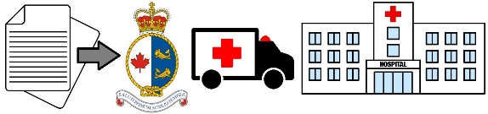
CARD 3
UNCONSCIOUSNESS
Possible Signs and Symptoms:
UNRESPONSIVE
(Casualty may be breathing or not breathing)
Perform ABCs
Insert Oral airway if needed
Start CPR if required
Attach Oximeter
Provide supplemental oxygen as needed ie if O2 Sat less than 95%
Take and Continue to Monitor vital signs, including level of consciousness (LOC)
Monitor patient’s condition
Document
Arrange for immediate transfer to the hospital
Notes:
Assess for head injury, see CARD 5, 7, 9 and 16 or other cause of unconsciousness.
First Aid person is not there to diagnose, but to observe and document.
UNCONSCIOUSNESS
CARD 3

Slide 15
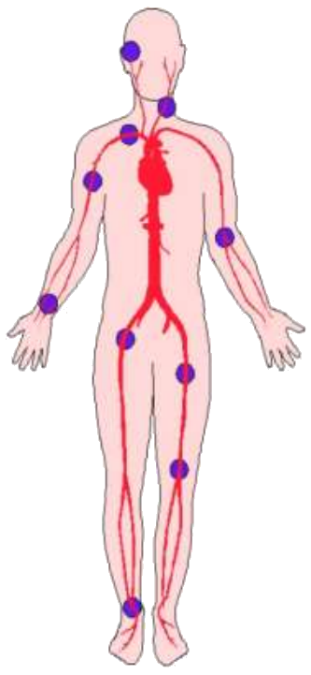
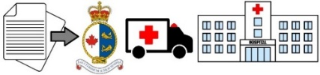
_{CARD 3} CONTROL OF EXTERNAL BLEEDING
Possible signs and symptoms:
• Breathing Rate 30+ • Cap refill 3+ secs • Pulse >120
• Pale • Cold and clammy • Loss of consciousness AVPU
• Keep injured casualties warm and handle gently •
EXTERNAL BLEED LIFE THREATENING BLEED
_{Sit or lie casualty down} Apply immediate direct or Expose and examine wound ^{indirect pressure}
_{Apply direct finger pressure} For limb bleeds use tourniquet to site and elevate if possible _{Dress wounds, consider Celox}
^{Apply trauma dressing} If in pain - GIVE ENTONOX _{If in pain - GIVE ENTONOX} UNLESS the casualty has head
_{UNLESS the casualty has head} or chest injuries or has been
or chest injuries or has been ^{diving in the last 24 hours} diving in the last 24 hours _{If not giving Entonox}
_{If not giving Entonox} GIVE OXYGEN @15 l/min
_{GIVE OXYGEN @15 l/min} via non-rebreather mask
^{via non-rebreather mask} DO NOT release tourniquet If dressing bleeds through
_{SLOWLY} Note time of tourniquet
use Windlass Technique ^{application on}
cards / tourniquet / forehead
If bleeding not controlled, treat _{Attempt to get casualty to} as Life Threatening Bleed _{hospital in under 2 hours}
₂₀₁₆ If casualty goes unconscious If casualty goes unconscious
_{July} maintain airway SEE CARD 1 maintain airway SEE CARD 1
-
_{1.0} NOTES
Do not pull out embedded objects. Pad around objects or open fractures.
_{VERSION} Pack deep holes with Celox dressings, then apply direct finger pressure.
DO NOT push Celox into Chest , Abdomen or Pelvic cavity.
CONTROL OF EXTERNAL BLEEDING CARD 3
CARD 4
ARTERIAL BLEEDING
Possible Signs and Symptoms:
Bright red blood spurting with each heartbeat.
Serious and must be stopped, LIFE THREATENING
Press down hard on pressure point between heart and bleeding site
Elevate site if possible
If bleeding not controlled, apply tourniquet on Limbs, See CARD 13 (and notes below)
Document time tourniquet was applied! (See Notes Below)
If unable to use tourniquet (ie in neck, shoulder or armpit). Apply Gloves and Pack wound with increasing amounts of gauze using direct pressure until bleeding stops.
Attach oximeter
Give supplemental oxygen as needed
Watch for signs of Shock, see CARD 2
Take Vital Signs when possible
Monitor Patient’s condition
Pressure Points
Document
Arrange EMERGENCY transport
....................
....................
Notes:
Severe Arterial bleeding can be fatal if not stopped.
Improvise tourniquet if necessary.
NEVER release tourniquet before TWO hours.
ARTERIAL BLEEDING
CARD 4
Notes:
Open fractures has a separate card. I think “Don’t pull out embedded objects is relevant here

Slide 16





_{CARD 21} UNKNOWN ILLNESS
Consider F.A.S.T. for Stroke:
• Face: Does the casualty’s face droop on one side?
• Arms: Can the casualty raise both arms and keep them there?
• Speech: Is the casualty’s speech slurred / altered?
• Time: To rapidly evacuate!
The treatment of an unknown illness or Stroke will fall into one of the following three categories:
₁ UNCONSCIOUS ₂ UNCONSCIOUS
NOT BREATHING BREATHING
Give CPR SEE CARD 2 SEE CARD 1 - MEDICAL
3 CONSCIOUS
If in pain - GIVE ENTONOX UNLESS the casualty has head or chest injuries or has been diving in the last 24 hours
If not giving Entonox and SATS <94%
GIVE OXYGEN @15 l/min via non-rebreather mask
Reassure
2016
^{July} Use position of comfort
-
1.0
_{VERSION} Monitor and evacuate
UNKNOWN ILLNESS CARD 21
CARD 5
STROKE
Possible Signs and Symptoms: F.A.S.T.:
FACE: Face droop on one side.
ARMS: Raise Both arms, only able to do on one side.
SPEECH: Speech slurred or altered.
TIME: to rapidly evacuate.
Confusion; Trouble seeing; Loss of balance; Severe headache; Nausea; Loss of Bowel and Bladder control.
Perform ABC’s
CPR if unresponsive
Attach Oximeter
AED if appropriate
Do NOT give Aspirin
Supplemental Oxygen as needed (Oxygen sats less than 95%)
Check for head injury, cuts, bruises or other injuries
No fluids
Arrange emergency transport to hospital within 3 hours Hospital must have CT Scanner
Take Vital Signs
Monitor Patient’s condition
Document
Notes: Stroke patients have a much better chance:
Of survival
Of avoiding negative long term after ffects
Of minimal or less brain damage
IF THEY ARRIVE at hospital within the 3 Hour “Golden Window” in order to receive a clot busting medication.
STROKE
CARD 5

Slide 17
QUESTIONS

